Slide 1
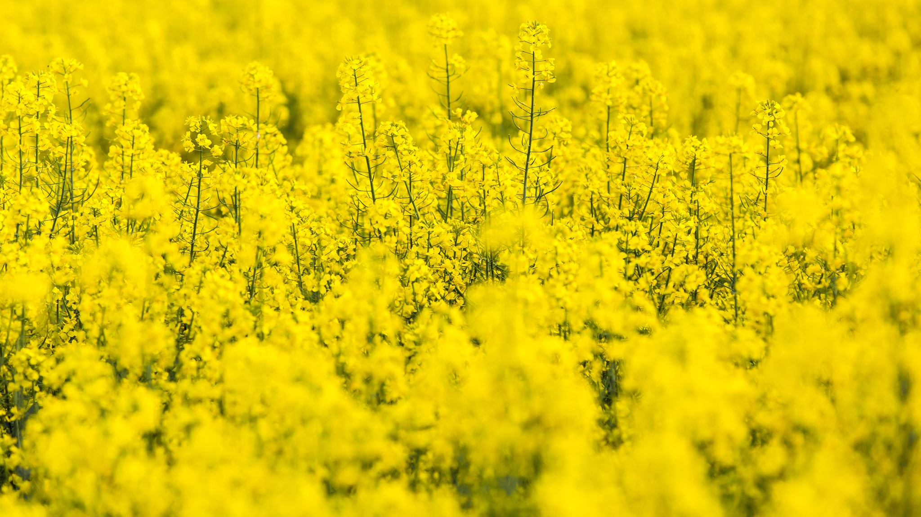
Field trial results
Boron in canola via soil and foliar application

Slide 2
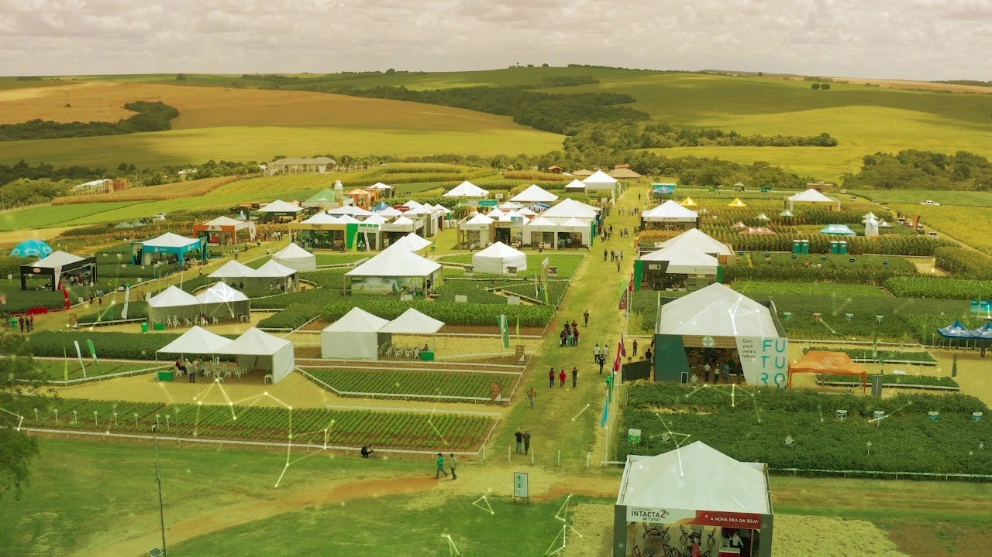
Trial overview:
Partner Institution: NexusBioAg
Locality: Nipawin, SK and Picture Butte, AB – Canada.
Date: 2023
Fertilizer: Granubor and Solubor
Soil Type and General Soil Information
Soil Boron content: 0.7

Slide 3
Response of canola to the application of B (via soil) Comparing control vs. Granubor in Nipawin, SK - Canada
Granubor provided 7.64% yield increase in comparison to the control treatment
0 lb/ac of B
1 lb/ac of B

Slide 4
Response of canola to the application of B (via foliar) Comparing control vs. Solubor in Picture Butte, AB - Canada
Solubor provided 4.4% yield increase in comparison to the control treatment
0 lb/ac of B

Slide 5
Results
Application of 1.0 lb/ac of boron via soil application (Granubor), provided 7.64% yield increase in comparison to the control treatment.
Application of 0.5 lb/ac of boron via foliar application (Solubor), provided 4.4% yield increase in comparison to the control treatment.

